Slide 2
The container-sprinkler system covered in this presentation is part of the patent for industrial invention No. 102015000084986 with RastaReed trademark with extension practice of European Patent No. 168388072.3 under the title "irrigation system with automatic irrigation liquid spraying device" and U.S.A. International application no. PCT / IT2016 / 000293 The current patent constitutes an advancement of the patent for industrial invention N ° 1230105 Italy and N ° 5095652 USA according to PCT entitled Rastaplan system "Technique for the cultivation of plants in protected and hobby agriculture“. The irrigation system called GostopWater is used with a reed device and has the IRRIPOT RastaReed mark.

Slide 3
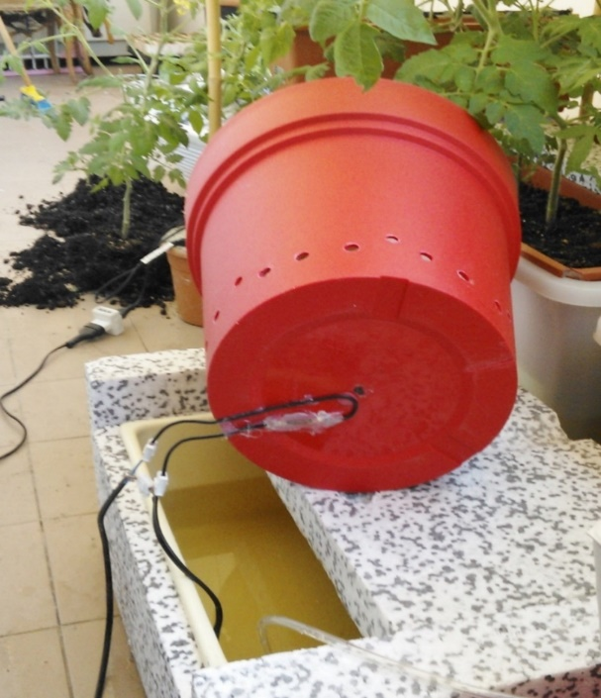
For the first time the gardener is relieved from determining the time of irrigation. Moreover, the system designed does not require timers as it is a direct sensor of the thermo-hygrometric conditions
and of the water - plant
absorption able to water and stop watering plants into the container.
The innovation made in the
patent for industrial invention
consists in equipping the
bottom structure of the
container with a reed device
that acts as a switch of the
irrigation system with magnetic
calibration float.

Slide 4
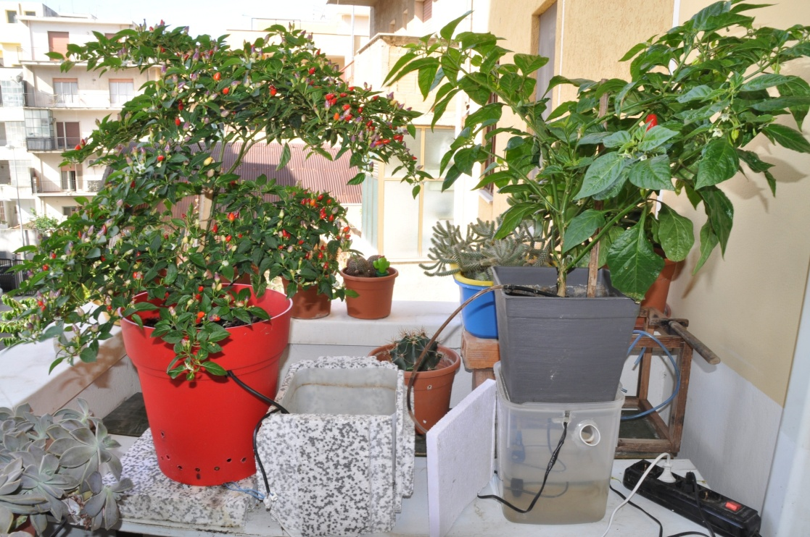

Slide 5
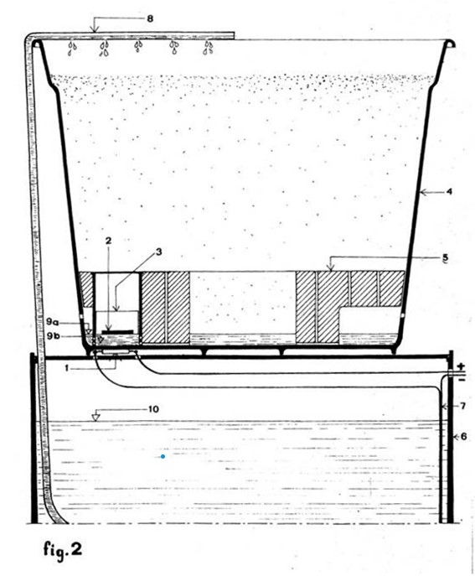
The figure represents an
artisan model used to conduct the
experimentation. In it the bottom is in expanded
polystyrene and follows the
functionality of the base
structure relating to the Irripot
container.
This creates a vast drainage
bottom crown of the substrate
and an internal well as an
area of contact between the
root system of the plant and
the draining water.
Legend:
1) reed device 2) magnet 3) float 4) container structure 5) structure of the bottom in expanded polystyrene 6) tank - water tank 7) electric cable of the submersible pump 8) water pipe 9a) detachment level of the reed contact 9b) bottom and reed contact level 10) level of irrigation water.

Slide 6
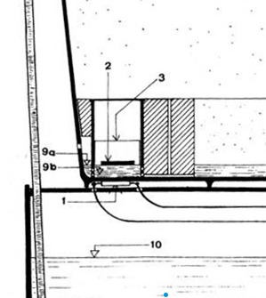
The reed is an electro-mechanical
component that functions as a
switch: open in the rest position
and closed in the presence of a
magnetic field.
In the container-sprinkler the
magnetic field is provided by a
magnet housed in the base of the
float.
This is inserted inside its own
guide and going down to the
bottom level of the container
causes the contact of the reed
sheets, which under the influence
of the magnetic field closes the
circuit that starts the submersible
pump. The supply will stop when the excess water collecting at the bottom of the container reaches the detachment level of the float due to the buoyancy thrust. The float moving away no longer provides (with its magnet) the magnetic field for the polarization of the reed blades and therefore, it returns to the open position.
Legend:
the excess water collecting at the bottom 1) reed device 2) magnet 3) float 4) bottom of the container reaches structure of the container 5) bottom the level of detachment of the
structure in expanded polystyrene 6) float due to the buoyancy, the tank - water tank 7) electric cable of the immersion pump 8) water pipe 9a) float moving away no longer release level of the reed contact 9b) supplies (with its magnet) the bottom and reed contact level 10) magnetic field for the polarization irrigation water level of the reed which therefore returns to the open position.

Slide 7
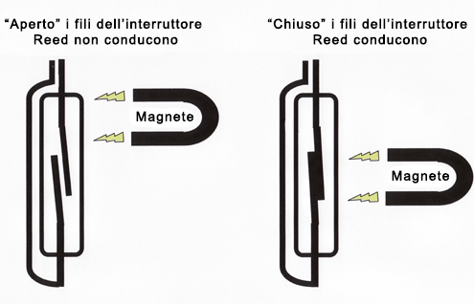
Therefore, the irrigation system
described achieves water
delivery without the need for
any timer.
Frequency and quantity of
water supplied is determined
by the radical absorption and
by the thermo-hygrometric
conditions in which it is placed;
since these determine the
Reed switch operation:
evaporation of the plant and
evaporation of the bottom
water of the container. The use
of the reed allows a targeted
and precise drip irrigation since
the sensitivity of the reed
allows the delivery to
evaporate a few millimeters of
the draining water present in
the saucer.
Reed switch operation :

Slide 8
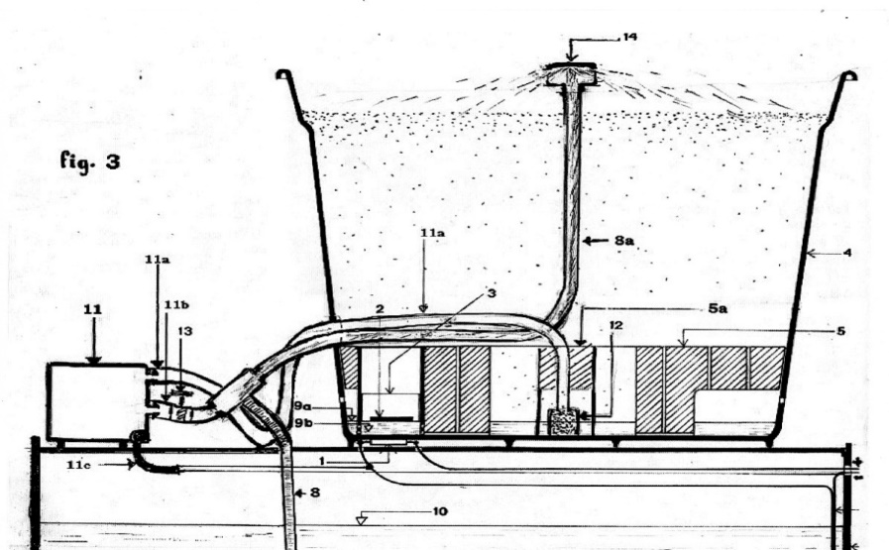
Model with spray irrigation
This constitutes an
"advanced" variant in
which the concept of
the draining air
chamber is expanded,
and in which a "forced
air spray" irrigation is
adopted in an original
way.
This system allows a
greater uniformity of irrigation compared to the drip irrigation
implemented in the previous model
described and an optimal oxygenation of the water.
Legend:
1) reed device 2) magnet 3) float 4) container
structure 5) structure of the dripping bottom in
expanded polystyrene 5 a) bottom pit
6) tank - water tank 7) electric cable of the
immersion pump 8) water pipe 8a) water pipe
driven by air
9a) disconnection level of the reed contact 9b)
background and reed contact level10) irrigation
water level 11) air pump 11a) 11b) air duct pipe
11c) air pump electric cable 12) porous stone13)
tap for adjusting the air and water flow rate 14)
spray dispenser.

Slide 9
In this case, a small air pump is used which is both to
introduce air into the bottom well of the container and to force
the water from the immersion pump.
The floating-magnet-reed opening and closing mechanism of
the GoStopWater system remains unchanged
In the system, in closed circuit, the water that arrives from the
immersion pump is pushed by the air coming from the air
pump, in laminar mode.
The acquisition of a certain kinetic energy allows to create a
"spray" dispenser. A surface is placed on the point of exit of
the water, which it breaks the water into little drops.

Slide 10
The advantages of this solution are :
- Maximum and optimal oxygenation of the irrigation water
supplied;
- Delivery modulation through an air flow tap;
- Possibility of dispensing water at a height greater than that of
flow rate of the immersion pump used.
Practically, adopting a 2-3 watt air pump is possible to supply
the flow of water to over 100 cm. height of a submersible
pump of 3 - 5 watts (with "classic" flow in height not exceeding
45 cm.)
The air pump is two-way, having one way out to serve the
purpose described above and the other, to be used for the
introduction of air into the bottom well.
This way the root system of the plant will find itself using an air
cushion at the moment of maximum watering (due to irrigation
in progress).
In the tested experiment, the solution is proved useful for
plants that remain for a long time in the container with the
same substrate which, inevitably undergoes some compaction

Slide 11
Irripot reed with drop and spray device has a considerable market among the so-called indoor growers who make specialized crops. In the volume of 6, 9, and 15 liters with water autonomy of 12 and 24 liters it satisfies the need for the most common crops among grow shop users and it allows indoor cultivation with coconut fiber even for beginners without the necessary knowledge on the subject irrigation. That is possible because the container-irrigator system acts as a direct sensor of the plant’s water needs, and of the thermo-hygrometric conditions in which it is surrounded.

Slide 12
The model with spray irrigation presents an innovative and more functional use of the air pump, which is usually used to oxygenate water. Since as illustrated it is used to drag the water coming from the small immersion pump in laminar mode allowing the highest value of gas exchange and therefore of water oxygenation. In the current panorama of the cultivation systems proposed by the grow shops the same imposes itself for innovation, competitiveness and above all for simplicity. It is the only irrigation system that does not require a timer and it provides a precise and targeted irrigation to the plant. Irripot-GSW creates an "easy grow ”, which it sets both the expert and the beginner grower in the best conditions.

